Slide 1

Introduction to Fire Corps

Slide 2
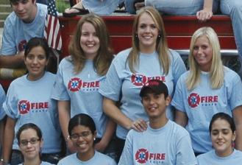
Fire Corps Mission
To utilize community members in non-emergency roles to supplement fire/EMS departments
Allows first responders more time to focus on training and emergency response
Departments able to expand services
Community members gain understanding of fire/EMS services and are better prepared in emergency situations
Photo courtesy of Dayna Hilton, Johnson County RFD#1 (AR)

Slide 3
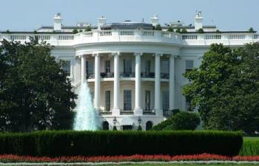


What is Fire Corps?
Launched December 2004 at the White House
Fire Corps National Advisory Committee (NAC) launched this initiative. Members included:
Congressional Fire Services Institute (CFSI)
Fire Department Safety Officers Association (FDSOA)
International Association of Arson Investigators (IAAI)
International Association of Black Professional Fire Fighters (IABPFF)
International Association of Fire Chiefs (IAFC)
International Association of Fire Fighters (IAFF)
International Association of Women in Fire & Emergency Services (iWomen)
International Fire Service Training Association (IFSTA)
Managed by the NVFC
Promotes a culture of service and responsibility
International Society of Fire Service Instructors (ISFSI)
National Association of Hispanic Firefighters (NAHF)
National Association of State Fire Marshals (NASFM)
National Fire Protection Association (NFPA)
National Volunteer Fire Council (NVFC)
North American Fire Training Directors (NAFTD)
Volunteers In Police Service (VIPS)

Slide 4
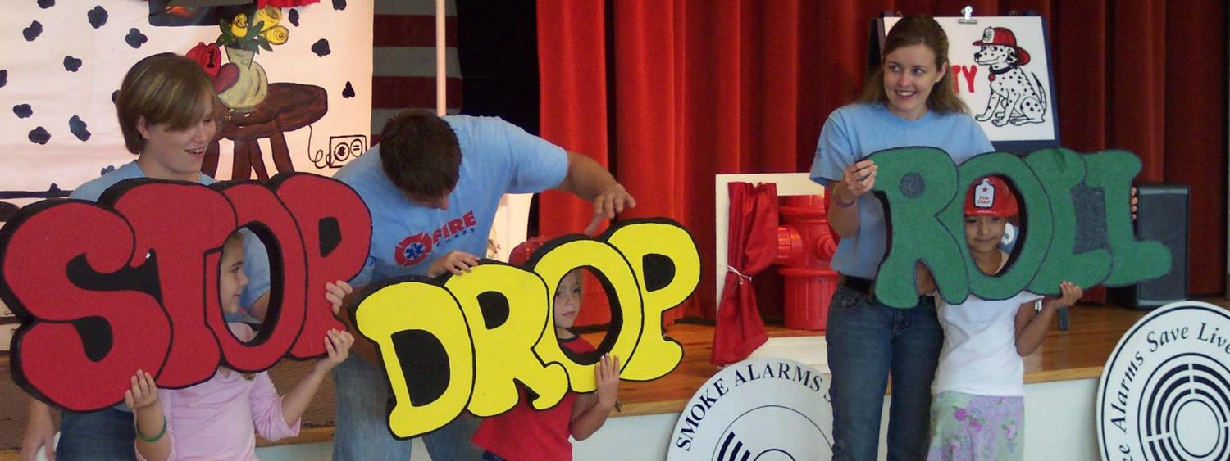
Making Communities Safer…
63% of departments with Fire Corps programs utilize citizens for fire prevention efforts and fire & life safety education
Photo courtesy of Dayna Hilton, Johnson County RFD#1 (AR)

Slide 5
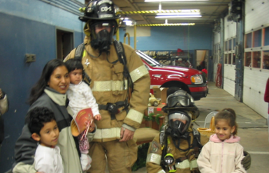
Stronger…
57% have increased support from the community
Others have noted increased support from state and local officials
“We have a growing Hispanic community here in Charlottesville and it's important for our firefighters to become more familiar with the Hispanic culture and language so that they can better serve those citizens.” - Linda Seaman, Charlottesville Fire Corps Director (VA)
Photo courtesy of Charlottesville Fire Corps (VA)

Slide 6
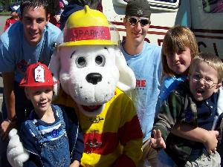
And Better Prepared…
41% have more time to train and respond to emergencies
68% use citizens for special projects such as hurricane relief, preparedness, and pre-planning
“We get constant comments from firefighters on how great it is to have a support program. Anytime we can use a civilian member rather than a fire department member, it helps.”
- Chief James Heenan, Northeast Teller County Fire Protection District (CO)
Photo courtesy of Dayna Hilton, Johnson County RFD#1 (AR)

Slide 7
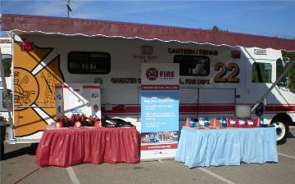
Helping Fire/EMS Achieve More
Fire prevention/life safety education
Special projects
Fundraising/grant-writing
Administrative support
Rehab/canteen
Chaplain services
And more
Photo courtesy of Greater Springfield Volunteer Fire Department (VA)

Slide 8
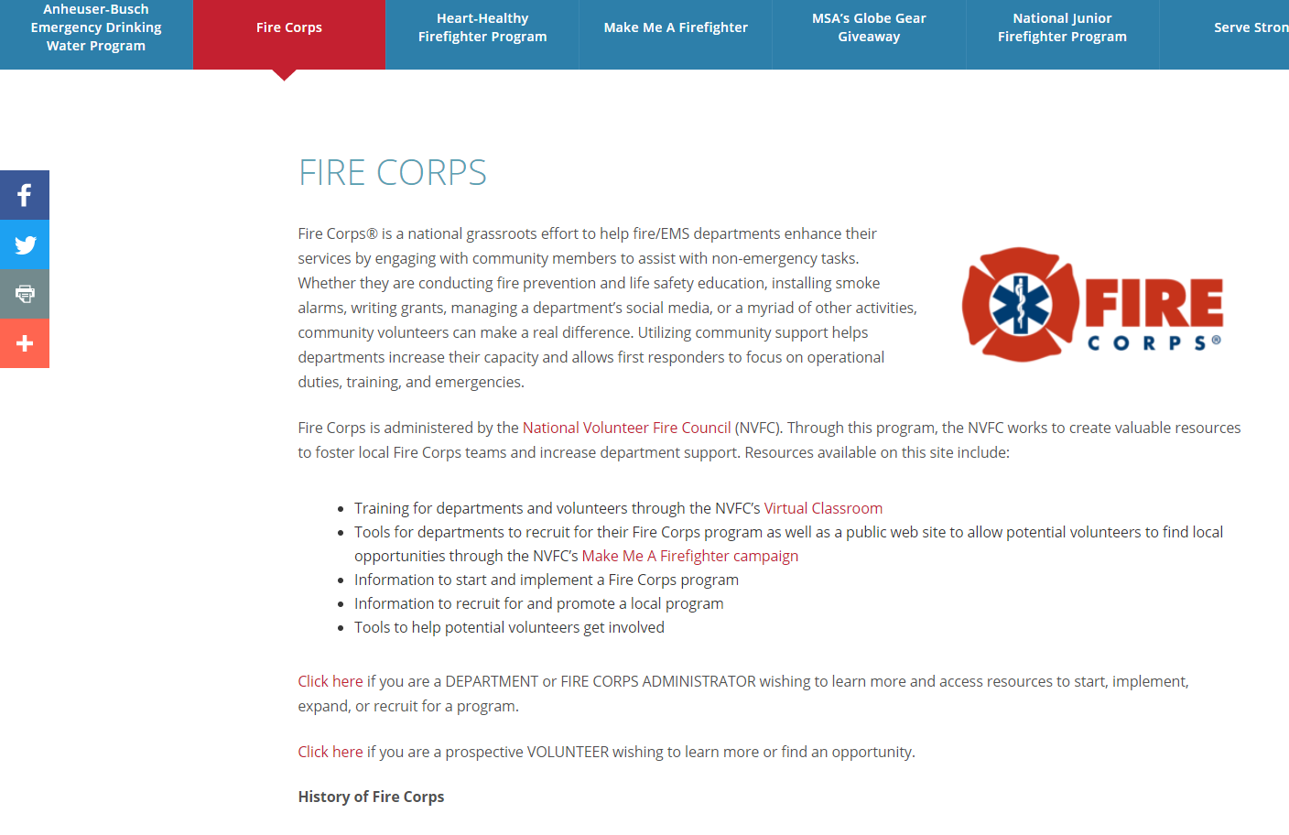
How Can We Help?
www.firecorps.org: number one source for information about the program
Get access to:
FAQs
Implementation tools
Marketing materials
Recruitment resources
Networking opportunities
Program profiles and highlights
Technical support

Slide 9

Resources
Fire Corps logo request
Customizable sample documents
Example documents provided by other Fire Corps teams
Guides and toolkits
Marketing and recruitment resources
New and innovative ideas and best practices
Online training at https://virtualclassroom.nvfc.org/

Slide 10
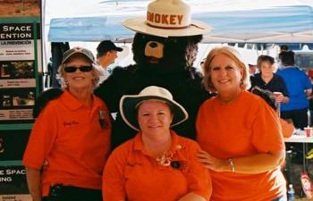
Getting Started
Design your program by creating the framework:
Perform needs assessment
Designate a leader
Draft an action plan
Visit www.firecorps.org for important tools and resources.
Photo courtesy of Ingleside Volunteer Fire Department (TX)

Slide 11
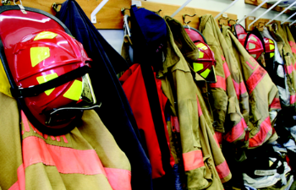
Consider
Costs:
Time and/or salary and benefits for program coordinator(s) if paid
Applicant screening
Specialized on-the-job training
Supplies, equipment, uniforms, etc.
Recognition
Liabilities:
Consult legal counsel and insurance provider
Utilize liability waiver or release form
Consult other volunteer programs within local government agencies
Applicable liability laws vary by state
Refer to Fire Corps Liability Guide for additional information

Slide 12
Grants & Funding
Assistance to Firefighters Grant (AFG)
Fire Prevention & Safety Grant (FP&S)
Staffing for Adequate Fire and Emergency Response (SAFER)
Local, state, and national foundations
Local, state, and national businesses

Slide 13
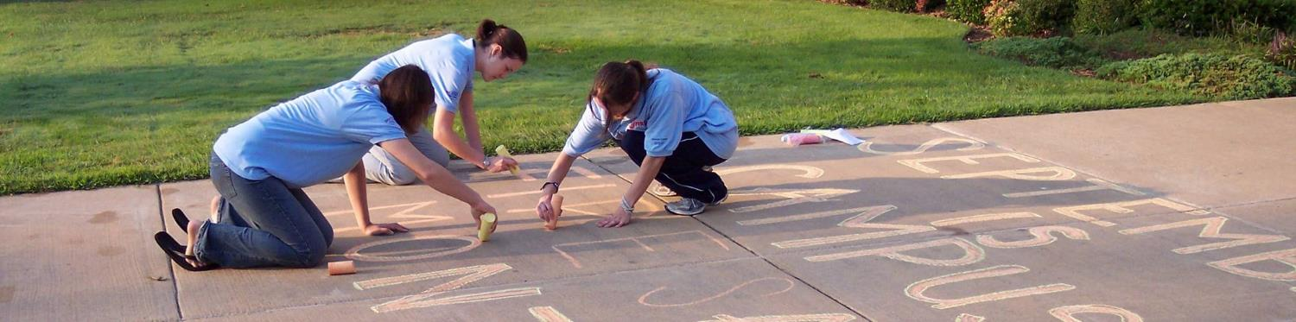
Recruiting Volunteers
Identify key places to recruit
Communicate that department needs assistance
Utilize Fire Corps resources at www.firecorps.org
Stress benefits and rewards for volunteering
Utilize MMAF campaign to post volunteer opportunities
Photo courtesy of Dayna Hilton, Johnson County RFD#1 (AR)

Slide 14
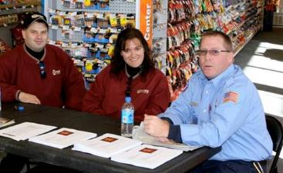
Selecting Volunteers
Communicate your needs to the community
Use a variety of media outlets to convey your message
Volunteer application form
List skills, experience, and availability
Screen applicants
Interview
Accept/decline
Photo courtesy of Macomb Township Fire Department (MI)

Slide 15
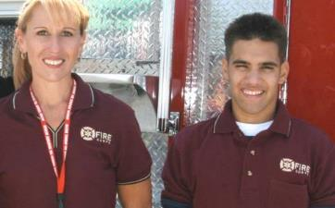
Retaining Volunteers
Provide uniforms
Recognize volunteer efforts
Write letters of commendation
Nominate volunteers for awards
Post photos of volunteers in action
Ask for feedback and act on it
Photo courtesy of Macomb Township Fire Department (MI)

Slide 16
Share Your Success
Publicize on social media and department’s web site
Submit press releases to local media outlets
Inform government officials about successes and program contributions
Research local businesses or other community organizations as possible partners to support your program

Slide 17
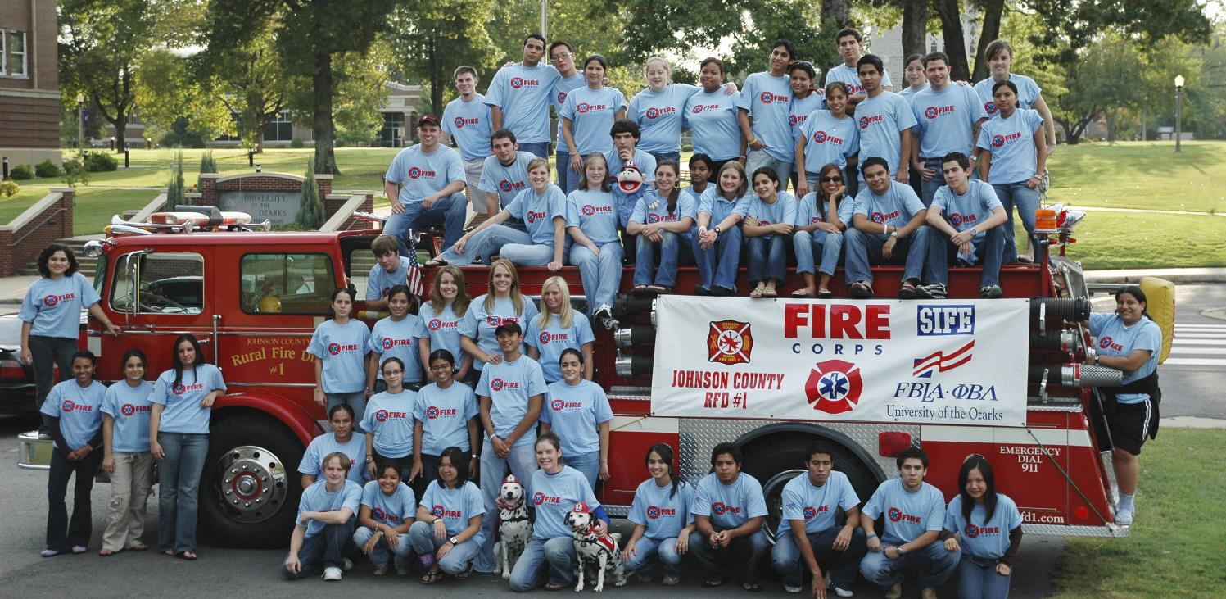
Questions?
www.nvfc.org/contact
v07.17.20
Photo courtesy of Dayna Hilton, Johnson County RFD#1 (AR)

